Slide 1
EC2 ecosystem

Slide 2
Agenda
EC2 Storage
Elastic Load Balancing
Auto Scaling Group

Slide 3
1. EC2 Storage
Subtitle

Slide 4
EBS volumes
high-performance block storage resources that can be used with EC2 instances
block storage volumes
A network drive, “limited” performance
Can only mounted to “one instance at a time”
Bound to a specific AZ

Slide 5
EC2 instance storage
If you need a high-performance hardware disk, use EC2 instance store
Better I/O performance
Lose their storage if they’re stopped (ephemeral)
Good for buffer/cache/scratch data/ temporary content

Slide 6
EFS – Elastic File System
Network file system that can be mounted on many EC2
Works with EC2 instances in multi-AZ
Use case: content management, web serving, data sharing
Use security group to control access to EFS
Compatible with Linux base AMI (not Windows)
Encryption at rest using KMS
File system scales automatically, pay-per-use, not capacity planning

Slide 7
Hands-on

Slide 8
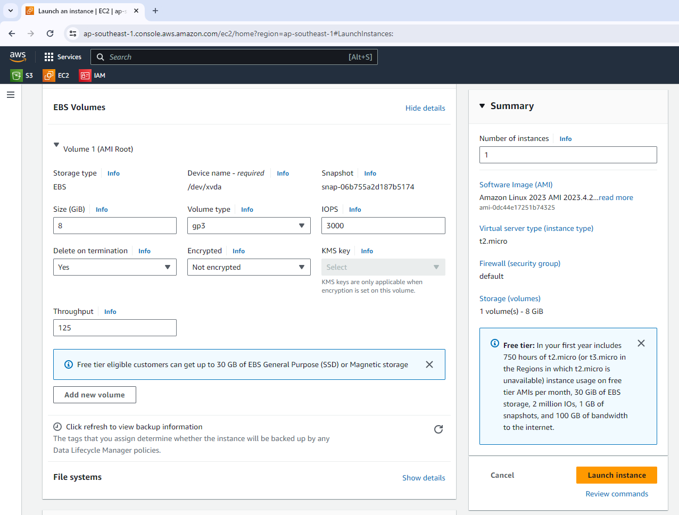
(1) Launch EC2 with EBS
Notes:
Launch EC2 instance with root volume, enable delete on termination, not encrypted

Slide 9
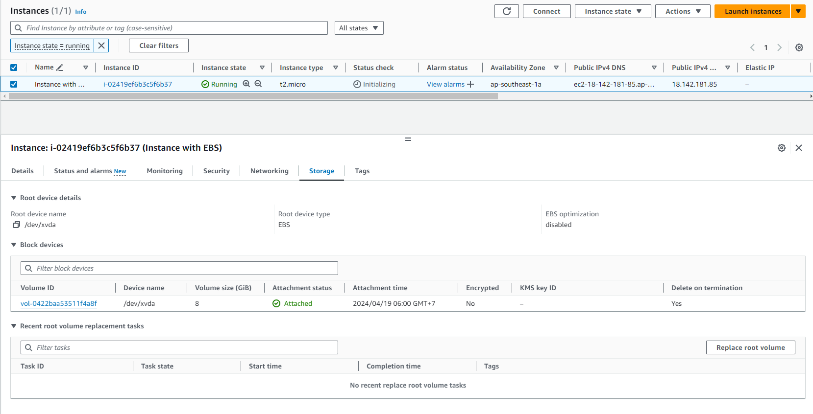
(1) Launch EC2 with EBS

Slide 10
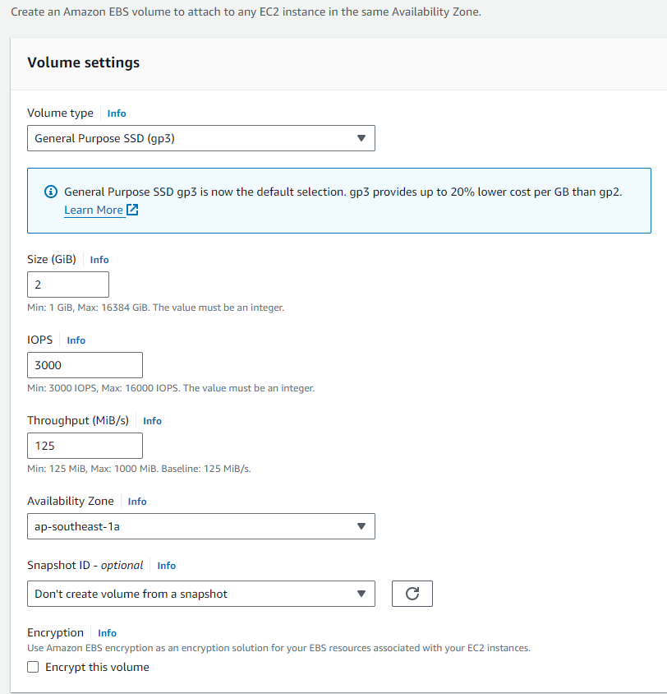
(2) Create EBS volume and attach to EC2

Slide 11
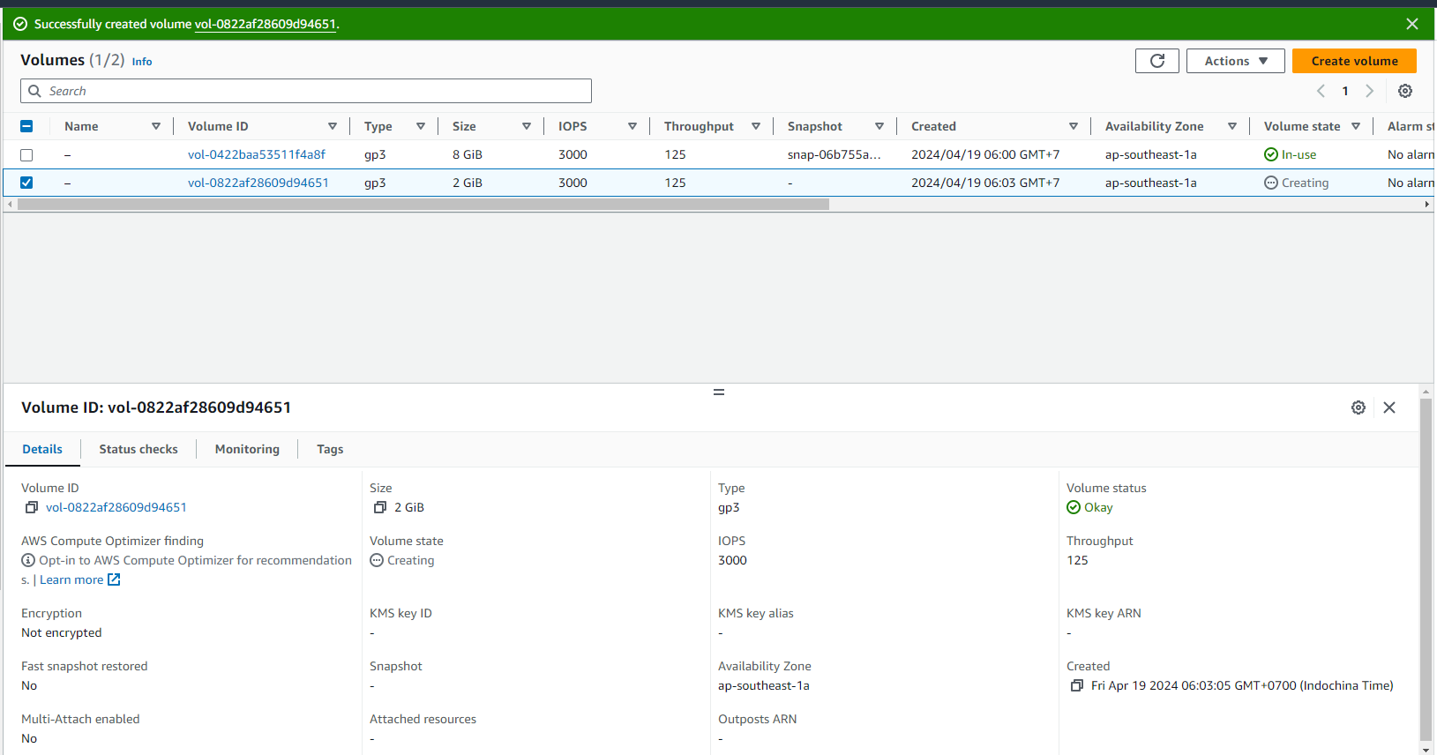
(2) Create EBS volume and attach to EC2

Slide 12
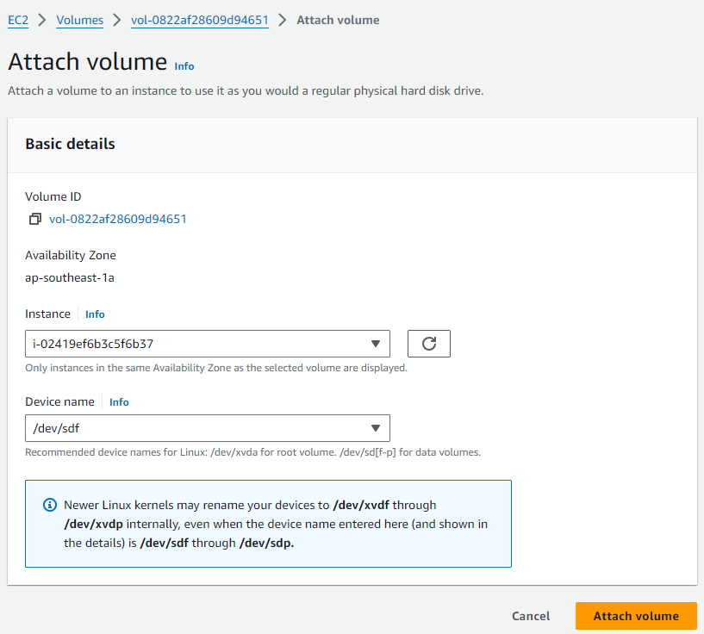
(2) Create EBS volume and attach to EC2

Slide 13
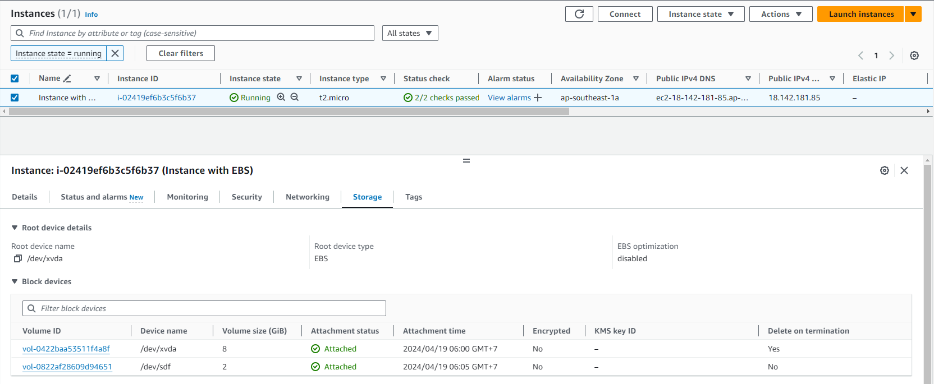
(2) Create EBS volume and attach to EC2

Slide 14
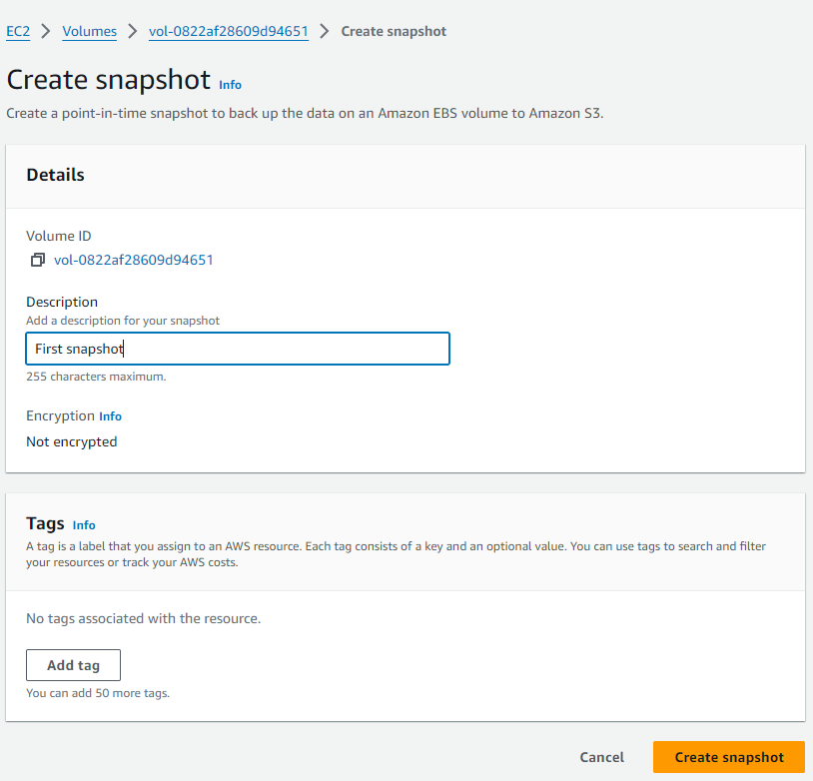
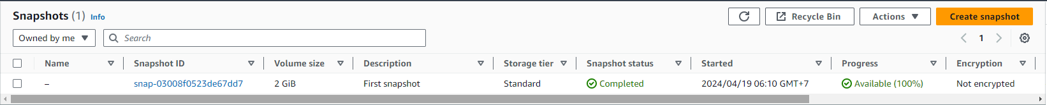
(3) Make EBS snapshot

Slide 15
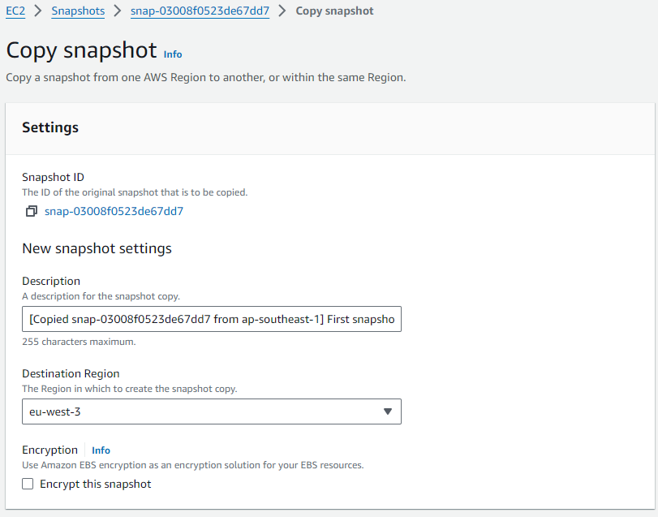
(4) Copy EBS to another region

Slide 16
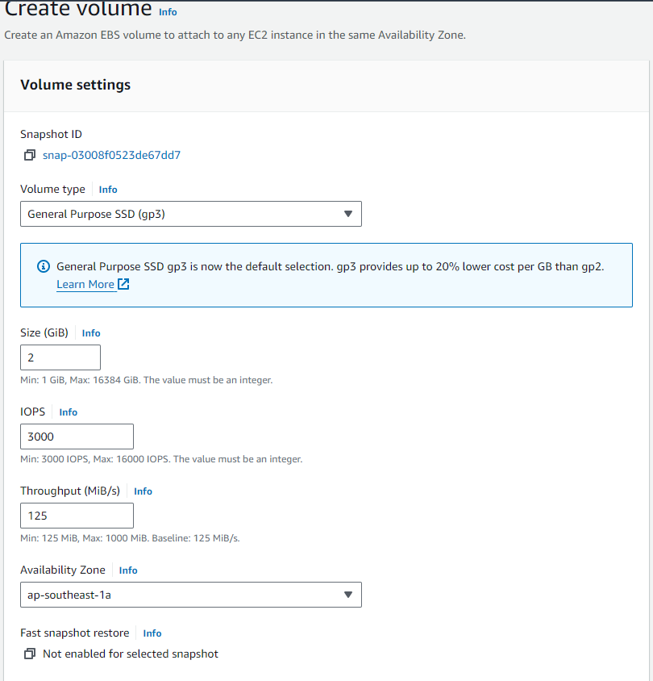
(5) Create volume from snapshot

Slide 17
(6) Cleanup

Slide 18
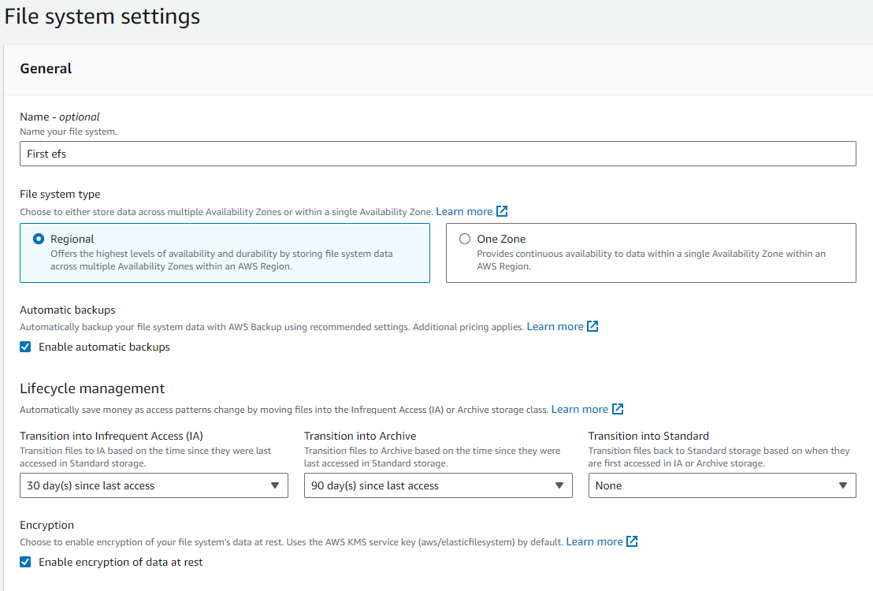
(1) Create EFS

Slide 19
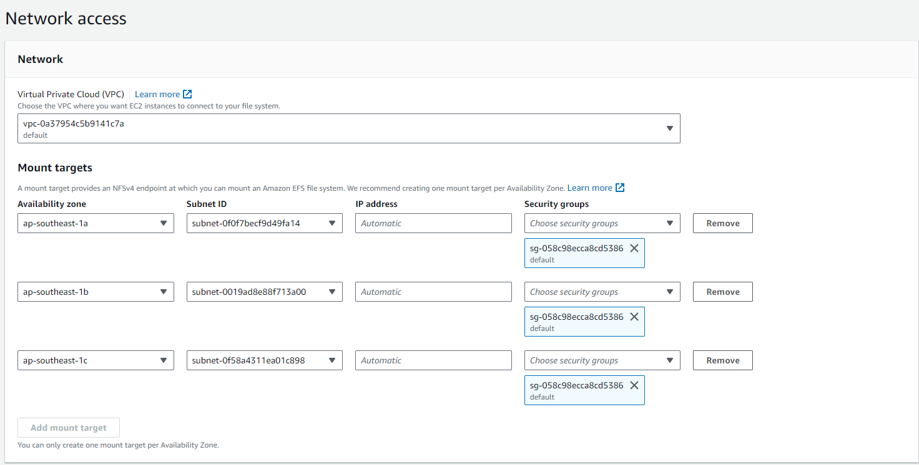
(1) Create EFS

Slide 20
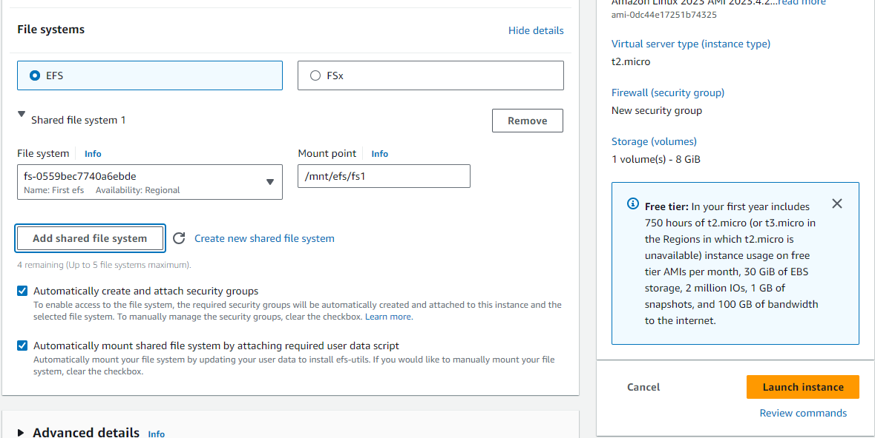
(2) Attach EFS to EC2 instance

Slide 21
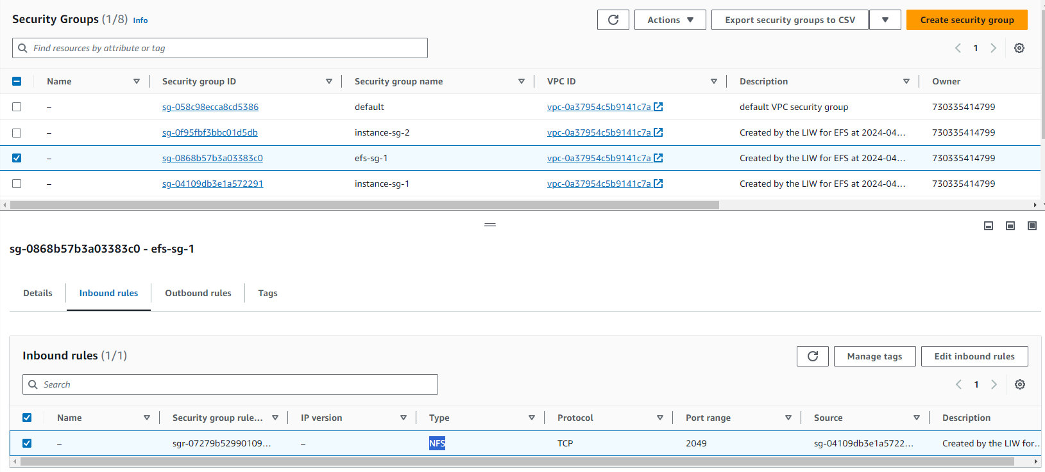
(2) Attach EFS to EC2 instance

Slide 22
(3) Cleanup

Slide 23
Elastic Load Balancing – ELB (CLB vs ALB)

Slide 24
What is ELB
distributes your incoming traffic across multiple targets, such as EC2 instances, containers, and IP addresses, in one or more Availability Zones
4 type: Application Load Balancers, Network Load Balancers, Gateway Load Balancers, and Classic Load Balancers.

Slide 25
Why use ELB
Spread load across multiple downstream instances
Expose a single point of access (DNS) to your app
Seamlessly handle failures of downstream instances
Do regular health checks to your instance
Provide SSL termination (HTTPS) for your website
Enforce stickiness with cookies
High availability across zone
Separate public traffic from private traffic

Slide 26
Hands-on

Slide 27
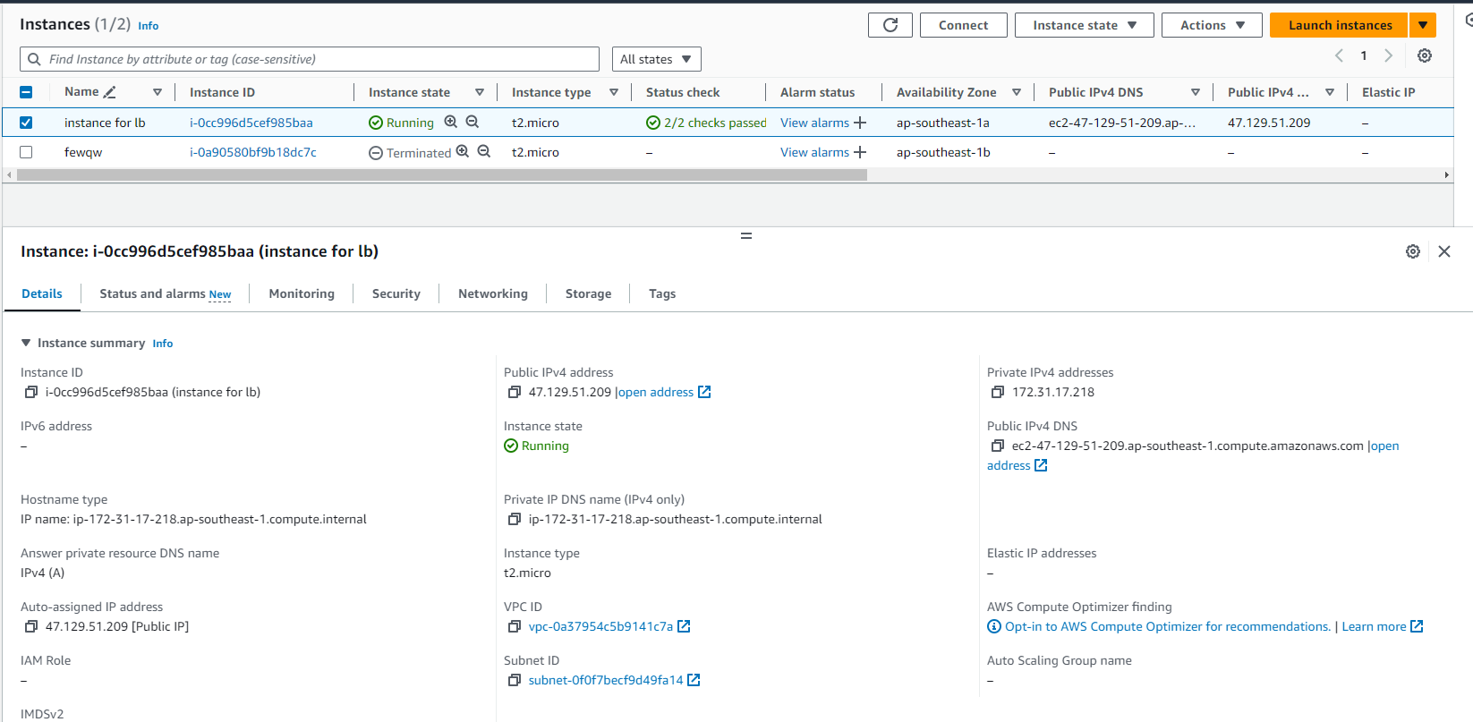
(1) Launch EC2 instance

Slide 28
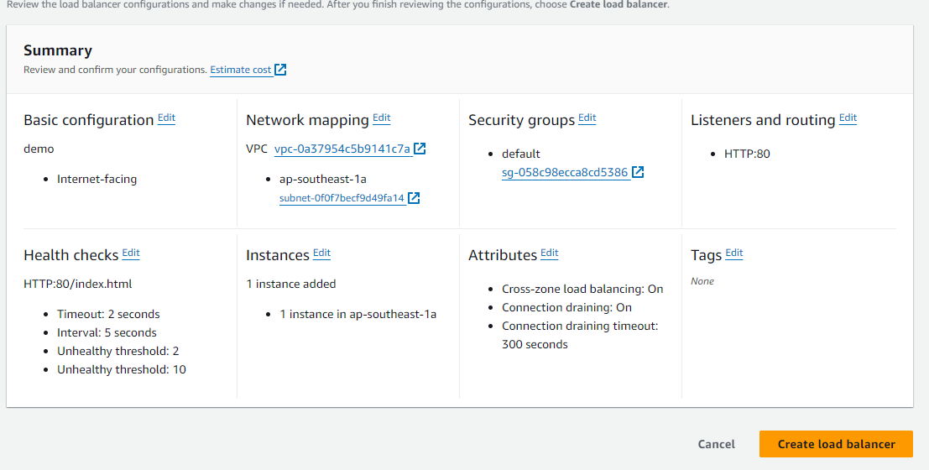
(2) Create Classic LB

Slide 29
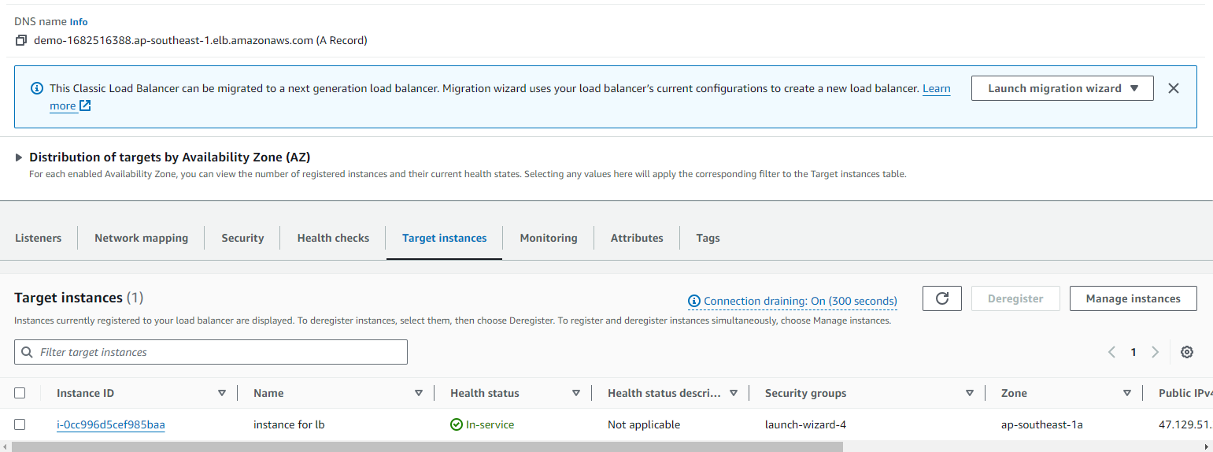
(2) Create Classic LB

Slide 30
(3) Cleanup Classic LB

Slide 31
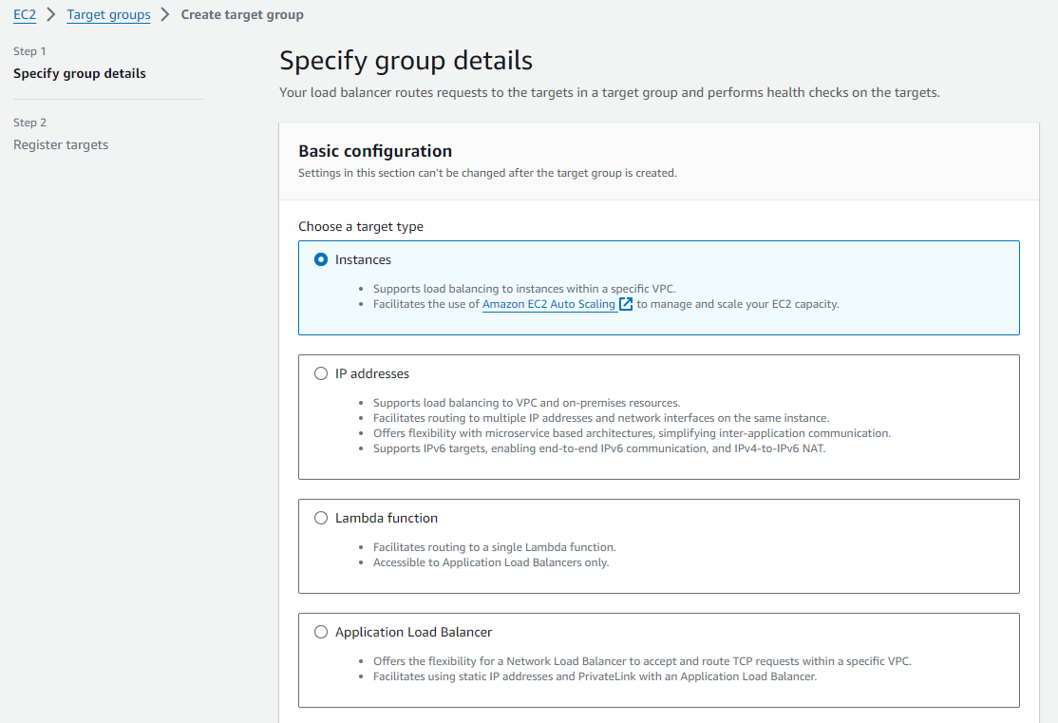
(3) Create ALB – target group

Slide 32
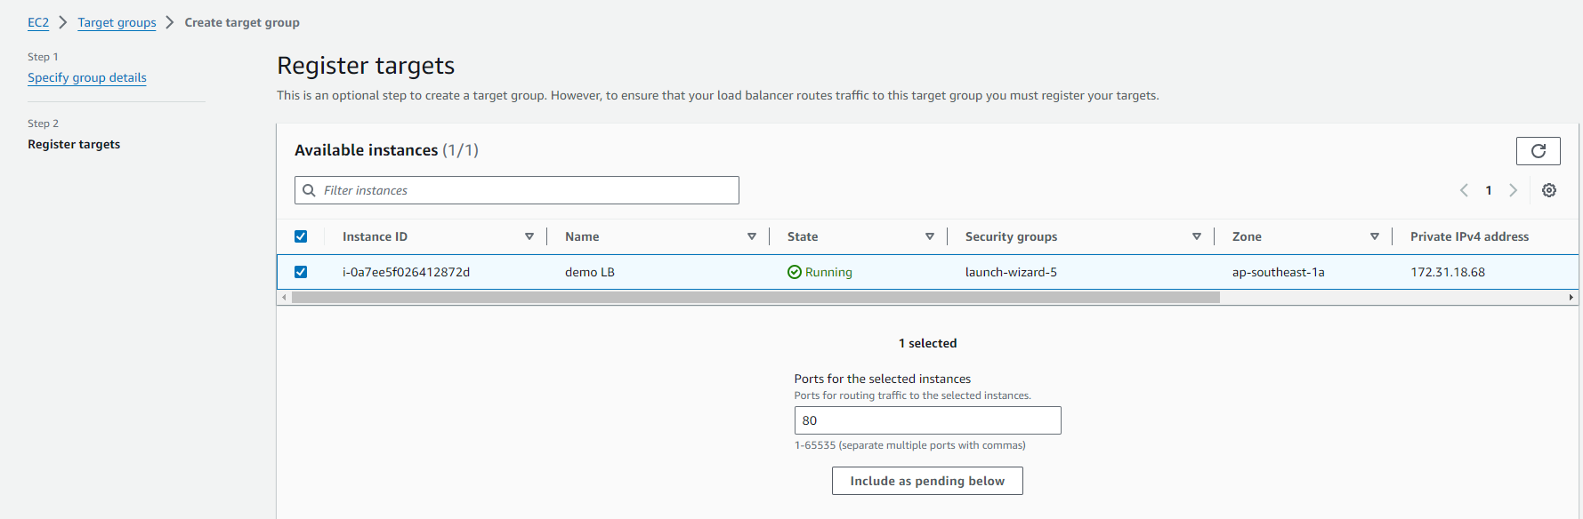
(3) Create ALB – target group

Slide 33
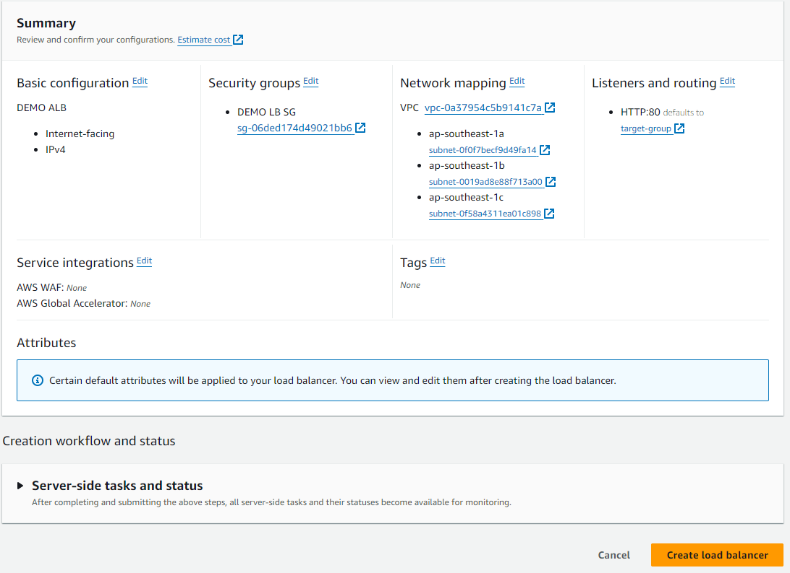
(3) Create ALB

Slide 34
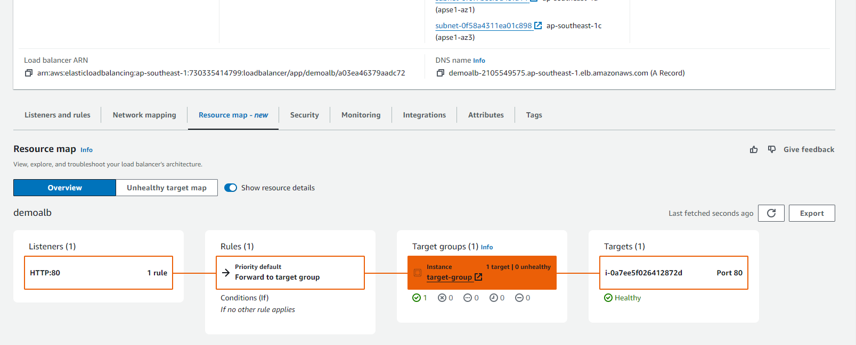
(3) Check connection ALB

Slide 35
(4) Cleanup

Slide 36
Auto Scaling Group

Slide 37
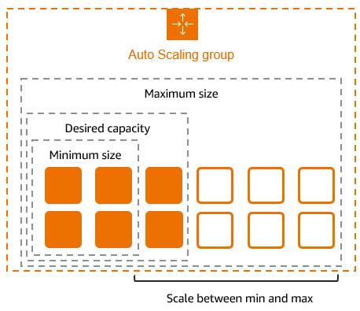
What is ASG
helps you ensure that you have the correct number of Amazon EC2 instances available to handle the load for your application

Slide 38
ASG – Dynamic Scale policies
Target tracking scaling
Simple/Step scaling
Scheduled Actions

Slide 39
Hands-on

Slide 40
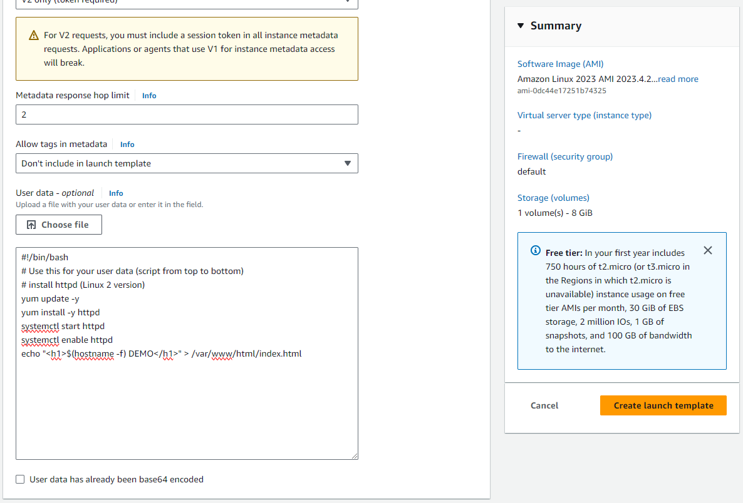
(1) Create ASG - Create launch template

Slide 41
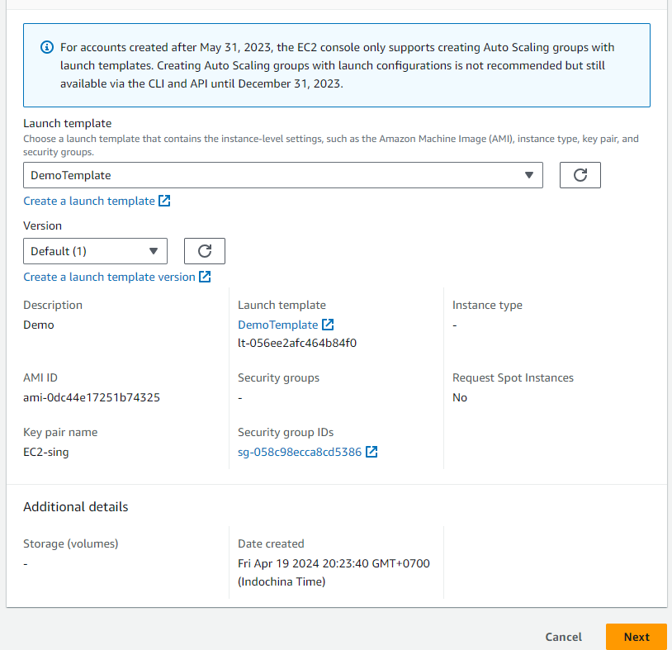
(2) Create ASG

Slide 42
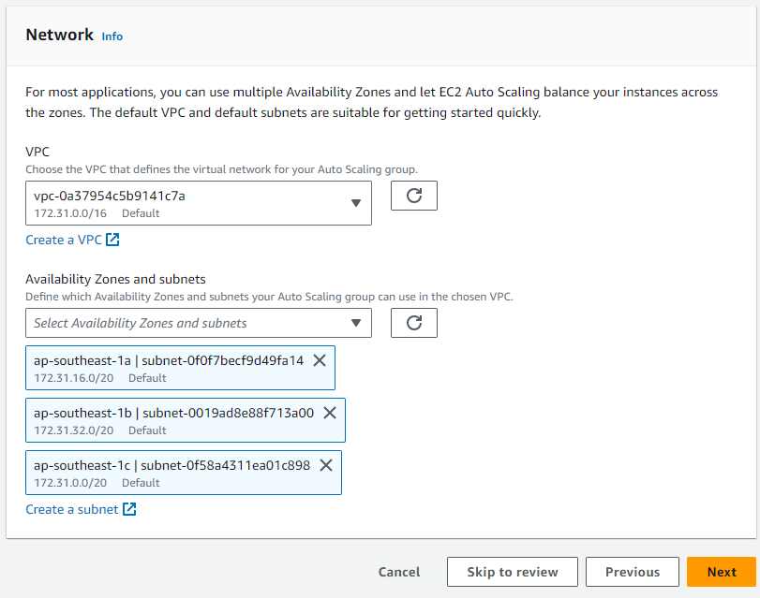
(2) Create ASG

Slide 43
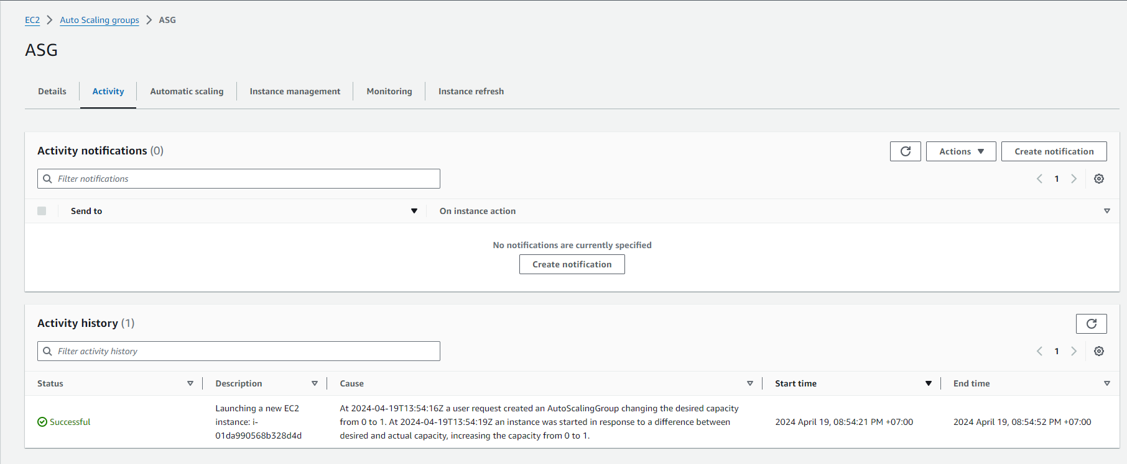
(3) Check ASG

Slide 44
(3) Change desired capacity (>1)

Slide 45
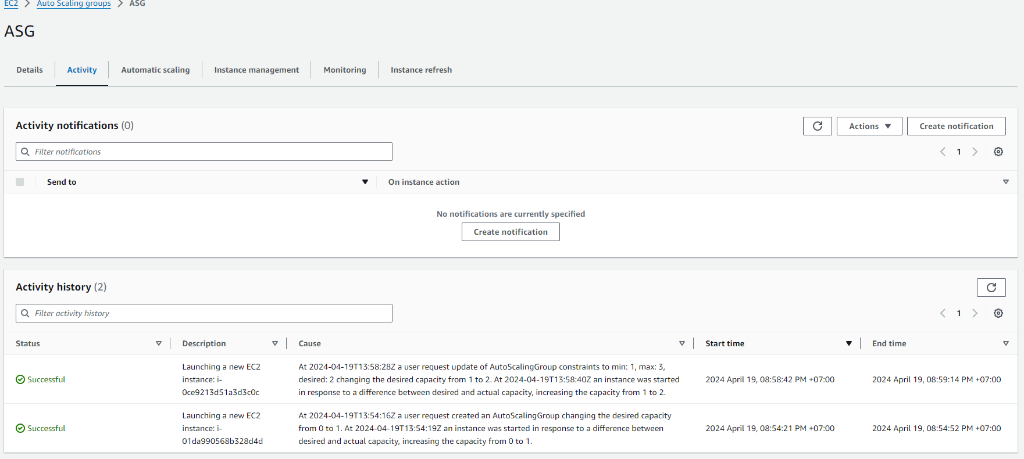
(3) Change desired capacity (>1)

Slide 46
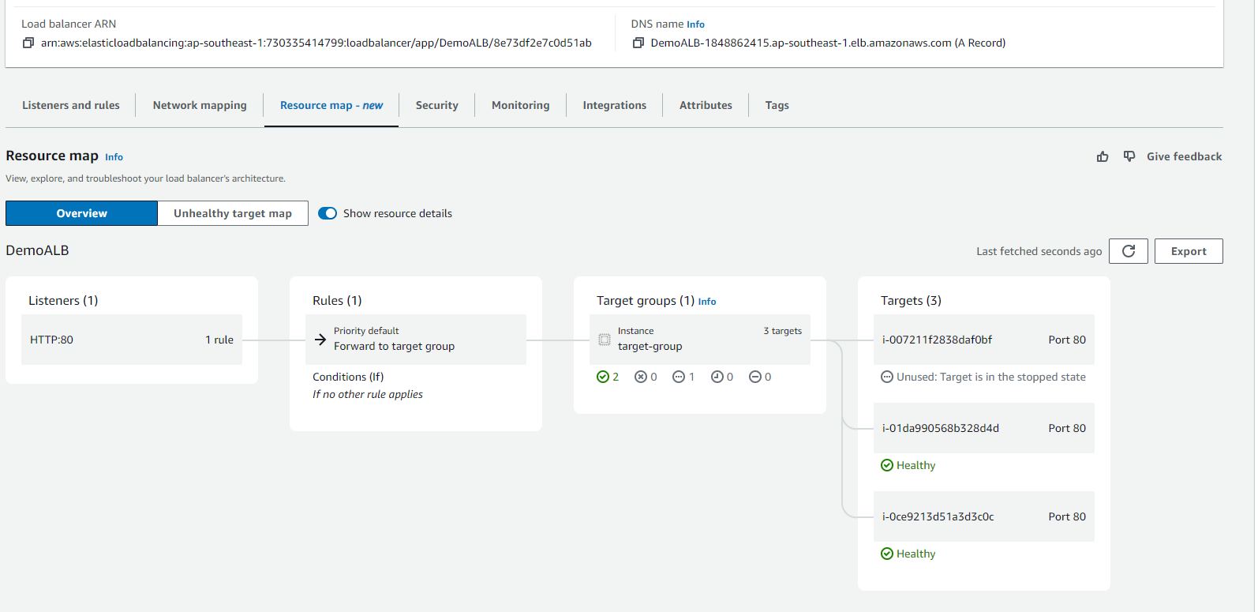
(3) Change desired capacity (>1)

Slide 47
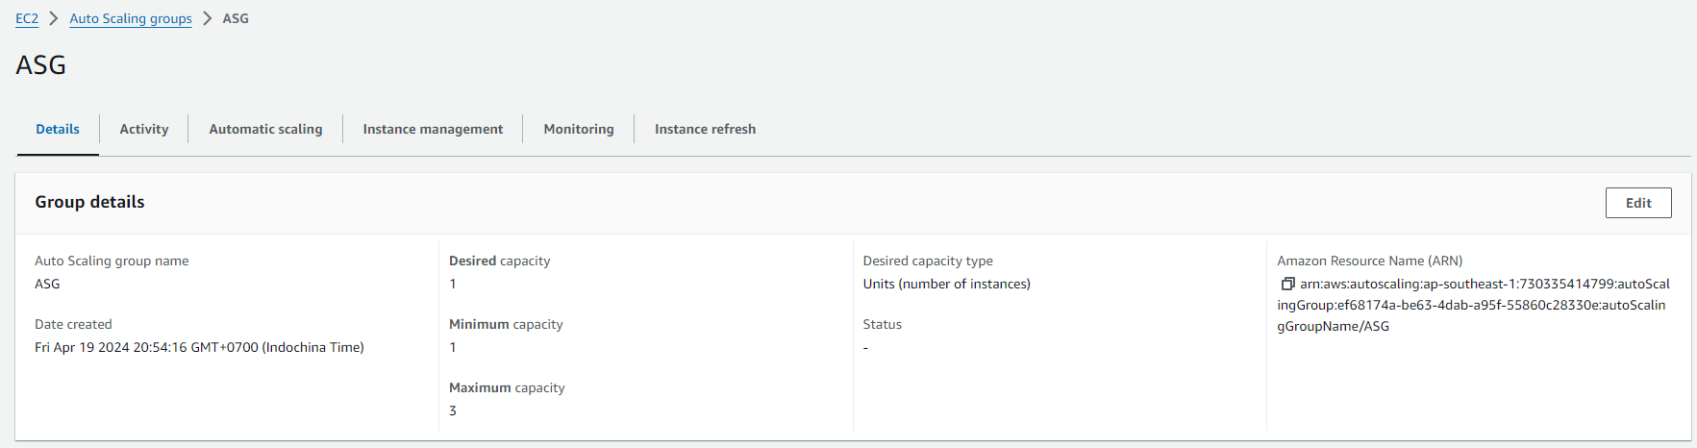
(4) Change desired capacity (=1)

Slide 48
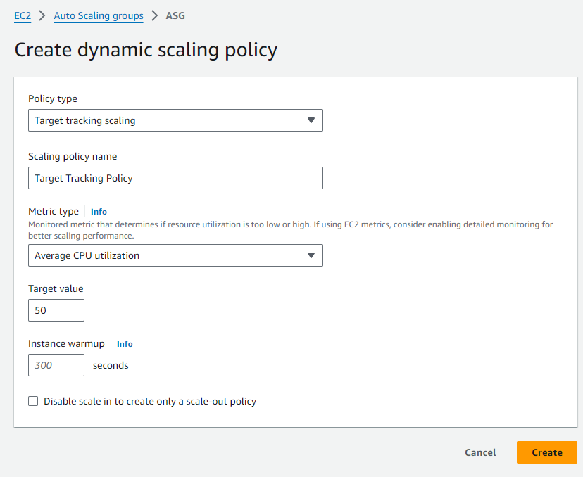
(5) Enable Target tracking Scaling policy

Slide 49
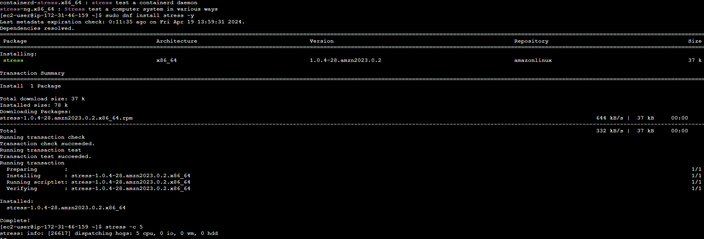
(6) Stress EC2 instance

Slide 50
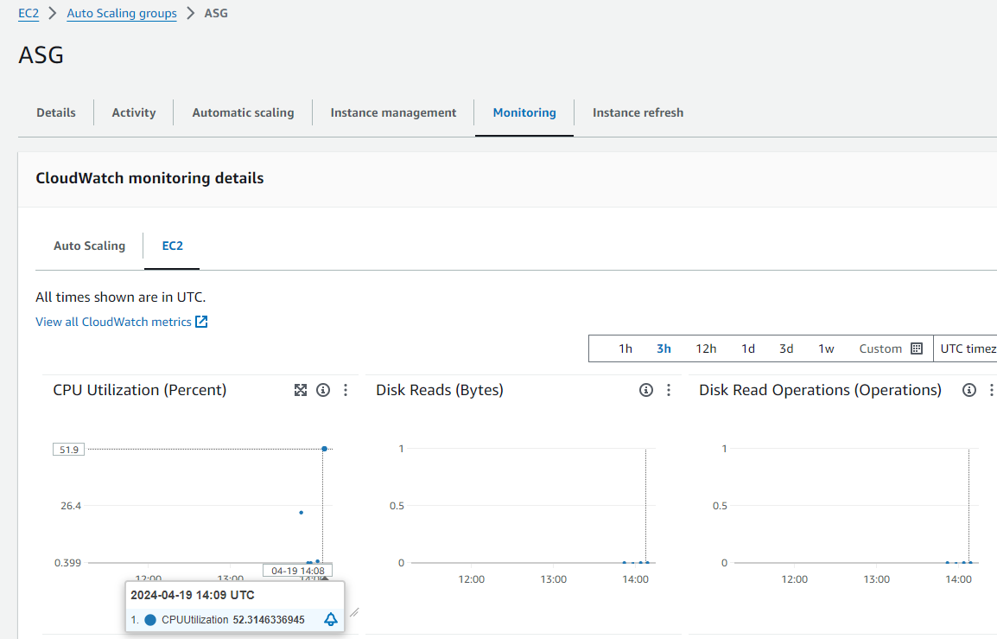
(6) Stress EC2 instance

Slide 51
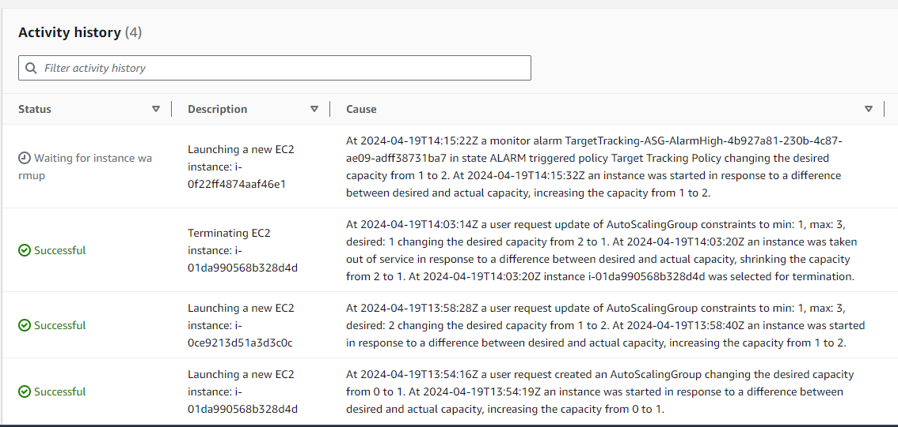
(6) Check ASG create new EC2 instance

Slide 52
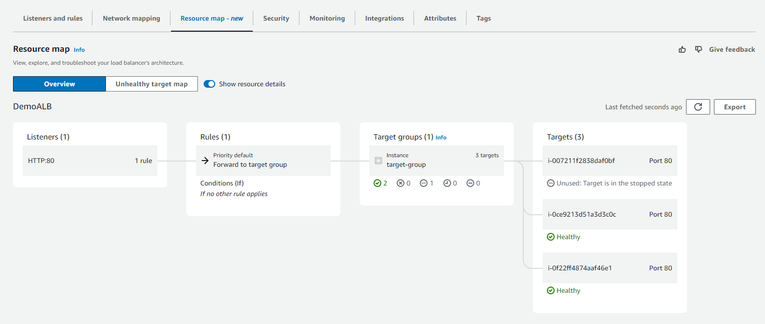
(6) Check ASG create new EC2 instance

Slide 53
(7) Cleanup

